Slide 1
ASP.NET CORE, PEEK INTO THE FUTURE
By Expert Network
@FII Practic

Slide 2
What we know so far...

Slide 3
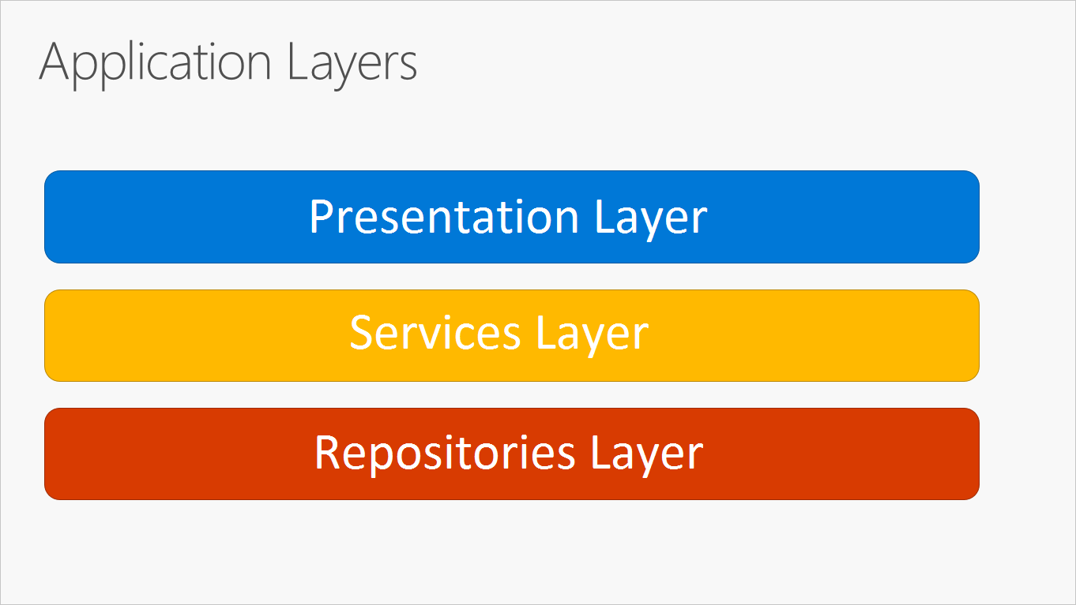
N-LAYER ARCHITECTURE

Slide 4
ExnCars Project Structure
ExnCars.Web - Presentation layer
ExnCars.Services - Our Business Logic
ExnCars.Data - Entities and EF Context

Slide 5
ExnCars Project Structure
ExnCars.Web
ExnCars.Services
ExnCars.Data

Slide 6
Our Database Structure
Vehicles (Id, VIN, RegDate, RegNumber,...)
VehicleDetails (VehicleId, ExtColor, IntColor, LastMotDate)
Models (Id, Name, ModelYear, EngineCode, EngineDisplacement)
Brands (Id, Name, LogoUrl, IsDeleted)
Users (Id, FirstName, LastName, BirthDate, Email, Password, Avatar)

Slide 7
What about the relations?
Types of relations:
1 - 1 (one-to-one)
1 - n (one-to-many)
m - n (many-to-many)

Slide 8
What about the relations?
Types of relations:
1 - 1 (Vehicle - VehicleDetails)
1 - n (Brands - Models)
m - n (Users - Vehicles)

Slide 9
Users - Vehicles
We need a new table to make this happen (UserVehicles)
many-to-many relations usually are broken into two one-to-many relations.

Slide 10
PRACTICE: Creating Entities
Entities
Context
Relations

Slide 11
CONVENTION PK OR DATA ANNOTATIONS PK
EF takes Id as PK by default
EF takes MyCustomKey as PK
public class User
{
public int Id { get; set; }
public string Name { get; set; }
}
public class User
{
[Key]
public int MyCustomKey{ get; set; }
public string Name { get; set; }
}
Notes:
To check that Annotations work even if not in Code-First context.

Slide 12
ONE TO MANY

Slide 13
A Brand has multiple Models
public class Brand
{
public int Id { get; set; }
public string Name { get; set; }
public string LogoUrl { get; set; }
}

Slide 14
A Brand has multiple Models
public class Brand
{
public int Id { get; set; }
public string Name { get; set; }
public string LogoUrl { get; set; }
public IList<Model> Models { get;set; }
}

Slide 15
CONVENTION FK OR DATA ANNOTATIONS FK
EF takes BrandId as PK by default
EF takes MyCustomFK as FK
public int BrandId { get; set; }
public Brand Brand { get; set; }
public int MyCustomFK { get; set; }
[ForeignKey(“MyCustomFK”)]
public Brand Brand { get; set; }

Slide 16
MANY TO MANY

Slide 17
Vehicles to Users relation
public class Vehicle
{
public int Id { get; set; }
public string VIN { get; set; }
...
public IList<UserVehicle> UserVehicles { get; set; }
public Vehicle() {
UserVehicles = new HashSet<UserVehicle>();
}
}

Slide 18
The Mappint Table
public class UserVehicles
{
public int UserId { get; set; }
public int VehicleId { get; set; }
public Vehicle Vehicle { get; set; }
public User User { get; set; }
}

Slide 19
REPOSITORIES

Slide 20
WHAT IS A CRUD
C – Create (insert into a table)
R – Read (select data from a table)
U – Update (update rows in a table)
D – Delete (delete data from a table)

Slide 21
Repository Pattern
“Mediates between the domain and data mapping layers using a collection-like interface for accessing domain objects.”
[https://martinfowler.com/eaaCatalog/repository.html]
Notes:
What it is
Why we use it
Benefits

Slide 22
Repository interface
public interface IRepository<T> where T : class
{
void Add(T entity);
void Update(T entity);
List<T> GetAll();
void Delete(T entity);
void Delete(IEnumerable<T> entities);
IQueryable<T> Query(Expression<Func<T, bool>> expression);
IQueryable<T> Query();
T GetById(int id);
}

Slide 23
GENERIC REPOSITORY
public class Repository<T> : IRepository<T> where T : class
{
private readonly DbSet<T> dbSet;
private readonly DbContext dbContext;
public Repository(DbContext dbContext)
{
this.dbContext = dbContext;
dbSet = dbContext.Set<T>();
}
...
}

Slide 24
Implementation
public void Add(T entity)
{
dbSet.Add(entity);
}
public void Update(T entity)
{
dbSet.Attach(entity);
dbContext.Entry(entity).State = EntityState.Modified;
}
public List<T> GetAll()
{
return dbSet.ToList();
}
public void Delete(T entity)
{
dbSet.Remove(entity);
}
public void Delete(IEnumerable<T> entities)
{
dbSet.RemoveRange(entities);
}
public IQueryable<T> Query(Expression<Func<T, bool>> expression)
{
return dbSet.Where(expression);
}
public IQueryable<T> Query()
{
return dbSet.AsQueryable();
}
public T GetById(int id)
{
return dbSet.Find(id);
}

Slide 25
PRACTICE: Creating a Generic Repository

Slide 26
SERVICES

Slide 27
BrandService
Return all Brands
Add a new Brand
Delete a Brand (soft delete)
Edit a Brand

Slide 28
Data Transfer Object
Moving data between layers
Has no logic inside it
Helps decoupling
Duplicate code
More to write

Slide 29
PRACTICE: Implement BrandService

Slide 30
IOC & DI

Slide 31
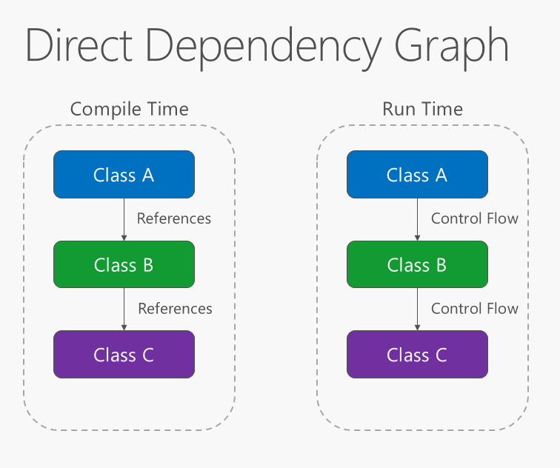
IOC & DI
[https://docs.microsoft.com/en-us/dotnet/architecture/modern-web-apps-azure/architectural-principles#dependency-inversion]

Slide 32
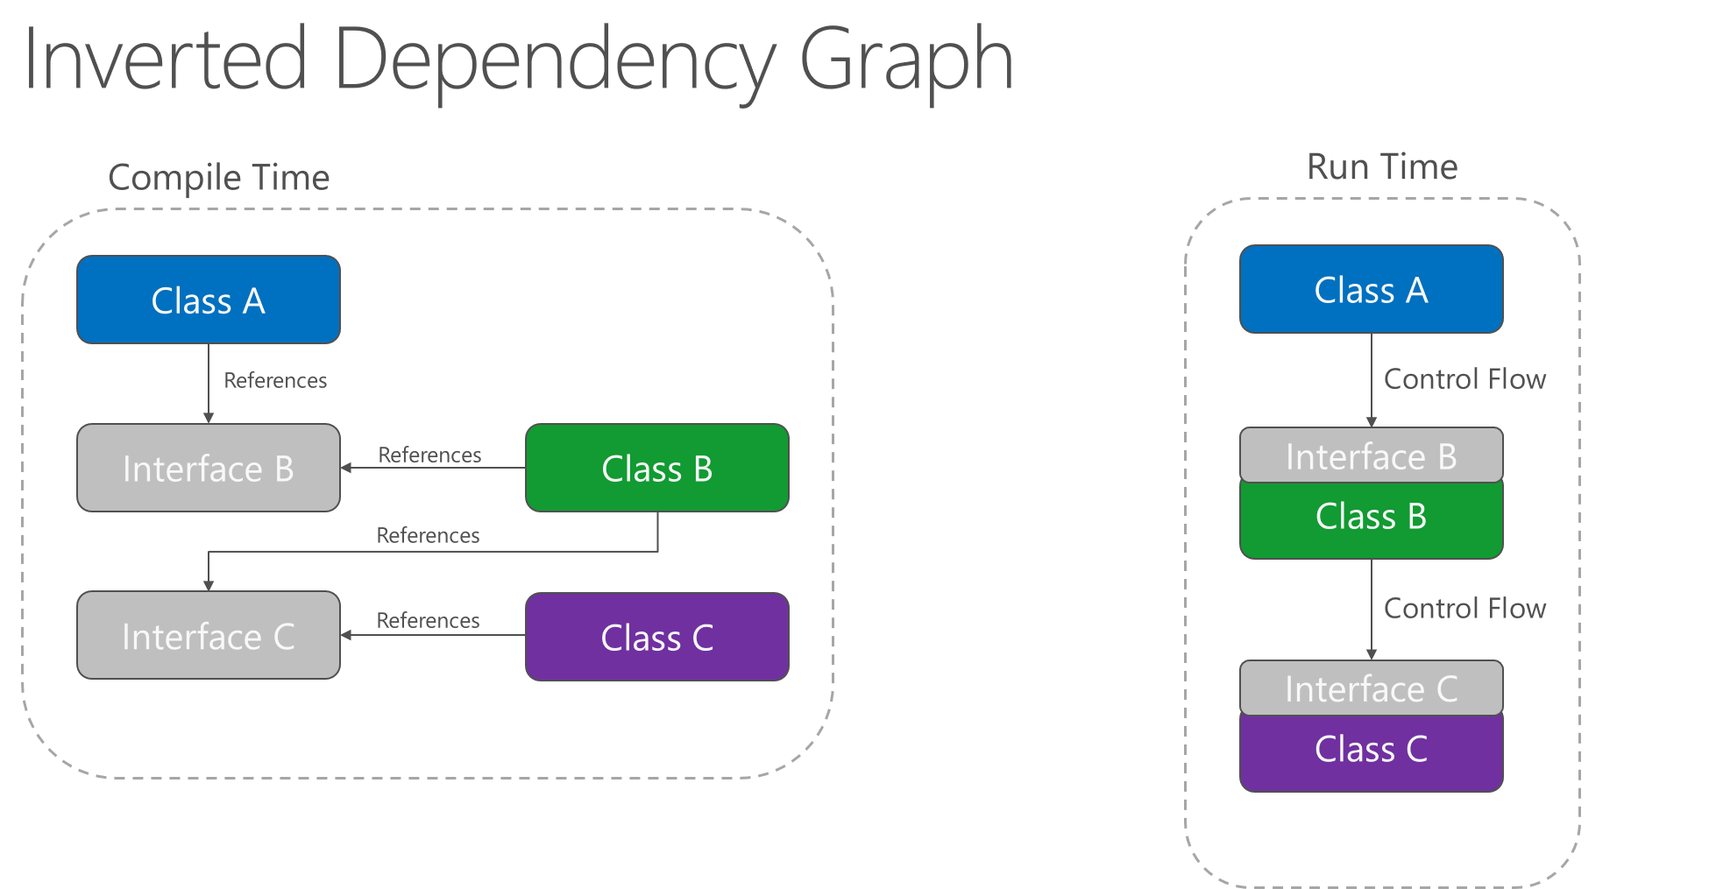
IOC & DI
[https://docs.microsoft.com/en-us/dotnet/architecture/modern-web-apps-azure/architectural-principles#dependency-inversion]

Slide 33
WHAT THOSE LETTERS MEAN?
IOC – Inversion of control
Design principle in which custom-written portions of a computer program receive the flow of control from a generic framework
DI – Dependency Injection
Technique whereby one object supplies the dependencies of another object

Slide 34
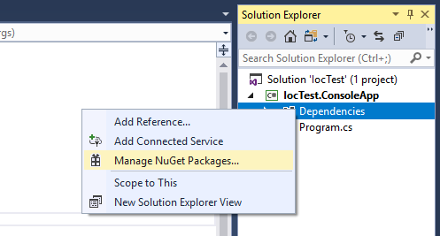
OPEN NUGET PACKAGES MANAGER

Slide 35
ADD THE PACKAGE
Microsoft.Extensions.DependencyInjection

Slide 36
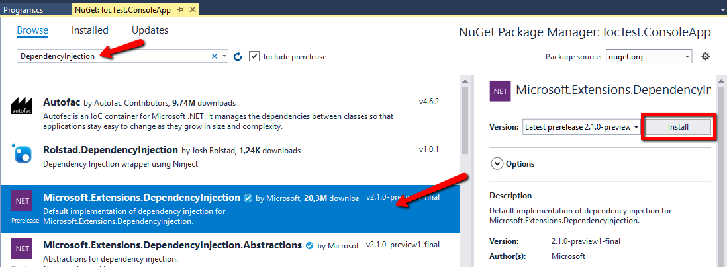
SOMETHING LIKE THIS

Slide 37
HOW TO USE IT
var serviceProvider = new ServiceCollection()
.AddTransient<IBookService, BookService>()
.AddSingleton<IDateTimeService, DateTimeService>()
.BuildServiceProvider();
//somewhere else
var bookService = serviceProvider.GetService<IBookService>();

Slide 38
DI LIFESTYLES
Transient
Singleton
Instance (not really a lifestyle)
Scoped (we will talk more about this when we use a web app)

Slide 39
WILL WE NEED TO ADD A ENTRY FOR ALL GENERIC REPOSITORY VALUES?

Slide 40
NOPE
var serviceProvider = new ServiceCollection()
.AddTransient<IBookService, BookService>()
.AddSingleton<IDateTimeService, DateTimeService>()
.AddTransient(typeof(IRepository<>), typeof(Repository<>))
.BuildServiceProvider();

Slide 41
HOW ABOUT THE DBCONTEXT?

Slide 42
MAKE SURE YOU HAVE THIS PACKAGE IN THE PROJECT
Microsoft.EntityFrameworkCore

Slide 43
IT SHOULD LOOK LIKE THIS
var serviceProvider = new ServiceCollection()
.AddTransient<IDatetimeService, DatetimeService>()
.AddTransient(typeof(IRepository<>), typeof(Repository<>))
.AddDbContext<DbContext>()
.BuildServiceProvider();

Slide 44
LET’S PUT EVERYTHING TOGETHER

Slide 45
PRACTICE: IOC Container

